Slide 1
After graduation…
Basic 10 – Unit 6b

Slide 2
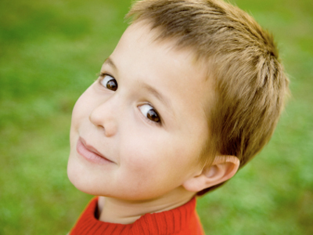
Child

Slide 3
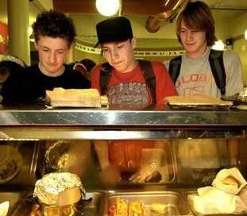
1. Teen age
Have time + Energy …. But No Money

Slide 4
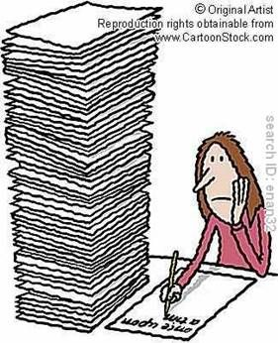
2. Working age
Have money + Energy …. But No time

Slide 5
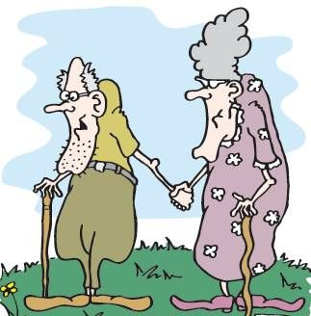
3. Old age
Have money + time …. But No energy

Slide 6
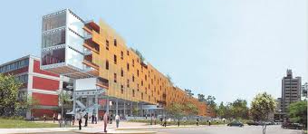
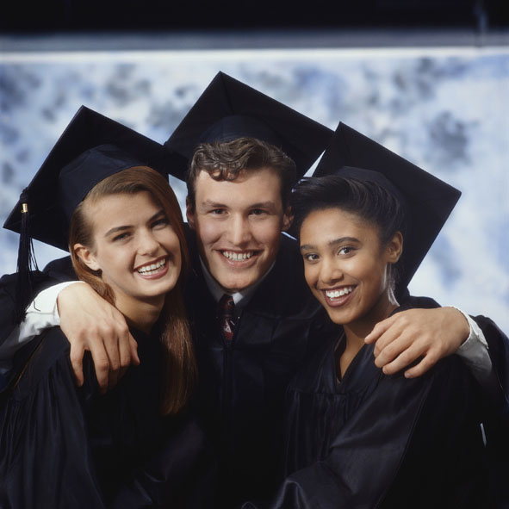
One of these days, I will be a student at RPU
Next month, I´m going to start my classes at RPU

Slide 7
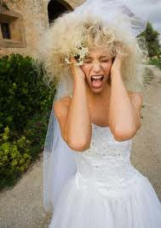
Get married

Slide 8
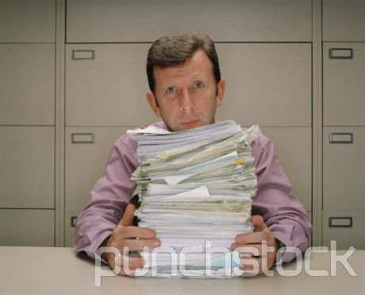

Slide 9
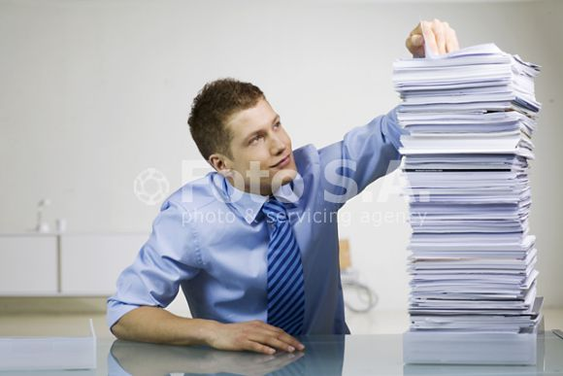

Slide 10
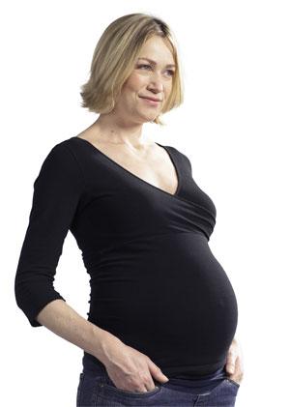
Have a baby

